Slide 1

Application of Cybersecurity: Robotic Vehicle Design
By Dev Patel
06/18/2025

Slide 2
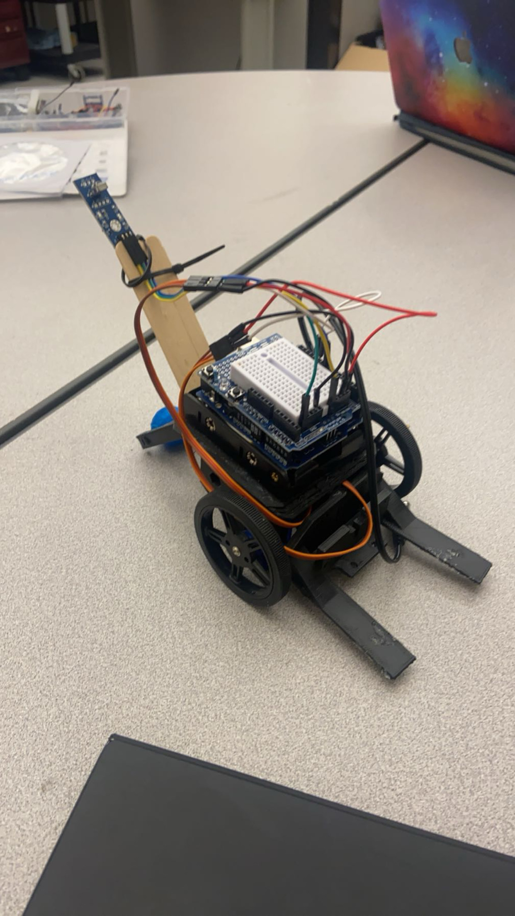
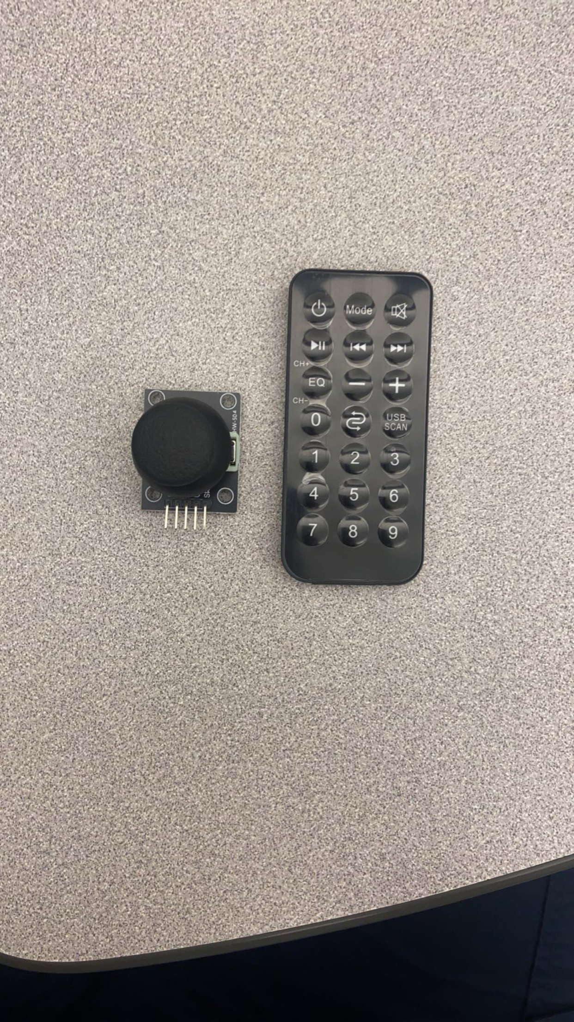
Project Overview
Semester long program to develop a remote controlled or autonomous robotic vehicle.
Tasks done in sprints every two weeks.
Utilized Arduino language.
Whoever collects the most wooden pillars wins.

Slide 3
Teams
1 Leader
1 Software Engineer
2 Quality Assurance Engineers

Slide 4
Competition Results
Consisted of 3 rounds
Achieved 1st place in the competition
Sensor Issue almost cost us

Slide 5
Application To Cybersecurity
Robot’s wireless connection to the remote control.
Can open up potential vulnerabilities if not safeguarded.
Such as Influencing robot with false data causing disruption and harm.
Camera access influencing privacy violations.
Application Security – Secure code? Used Sanitization? MFA?
Violation of Confidentiality, Integrity, and Availability.
ISO 27001:2022 Annex A Controls Ultimate Certification Guide

Slide 6
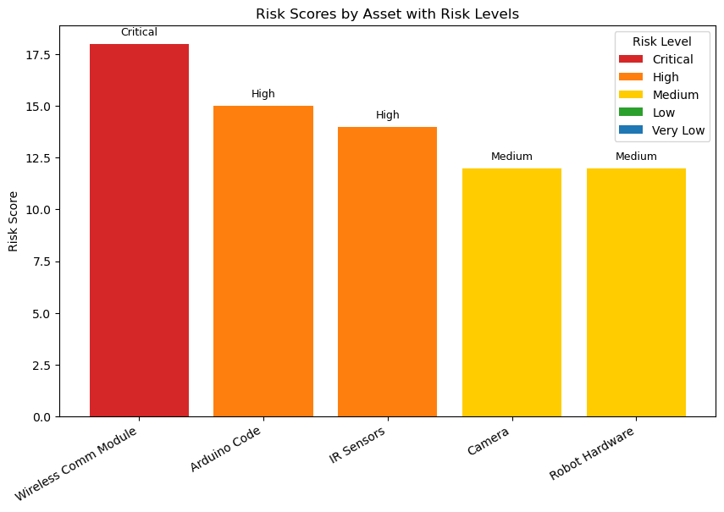
Risk Chart

Slide 7
Security Control Mapping Using ISO 27001:2022
Domain | Control used in Project | ISO 27001:2022 Annex A Reference | Explanation
Organizational | Manual code Reviews Sensor calibration | 5.1 Policies for Information Security 5.2 Roles and Responsibilities | -Have a policy mandating that all sensors be calibrated before each test/competition to ensure accuracy and reliability. -Each team role having defined responsibilities, similar to how ISO 27001 requires clear role definitions for security tasks.
People | Team role rotation (Scrum roles) Instructor feedback Awareness of secure coding practices | 6.3 Information Security Awareness, Education and Training 6.5 Responsibilities After Termination or Change of Employment | -Training each member on coding in Arduino, while constantly receiving instructor feedback. -Relevant in terms of role rotation, when us team members switch roles, we hand off responsibilities similar to offboarding in a real organization. Passing off what you completed and ensure they understand your work.
Physical | Robot stored in supervised area Lab access control | 7.1 Physical Security Perimeters 7.2 Physical Entry Controls | -Robot being stored in a supervised area, aligns with protecting physical spaces from unauthorized access. -Lab access control, only authorized students could enter the lab, protecting the robot and equipment.
Technological | Pairing remote to robot Fail-close mechanisms Input validation in Arduino code Camera always active when plugged in | 8.5 Secure Authentication 8.9 Configuration Management | -Secure pairing of the remote and the robot will strengthen security and complicate attack vectors, reducing the attack surface. -Fail-close mechanisms & sensor accuracy relate to ensuring systems behave securely under failure or misconfiguration.

